Slide 1

DRESS FOR SUCCESS
Frankie denmeade
ASMC/AGS Joint Spring Seminar
2012

Slide 2
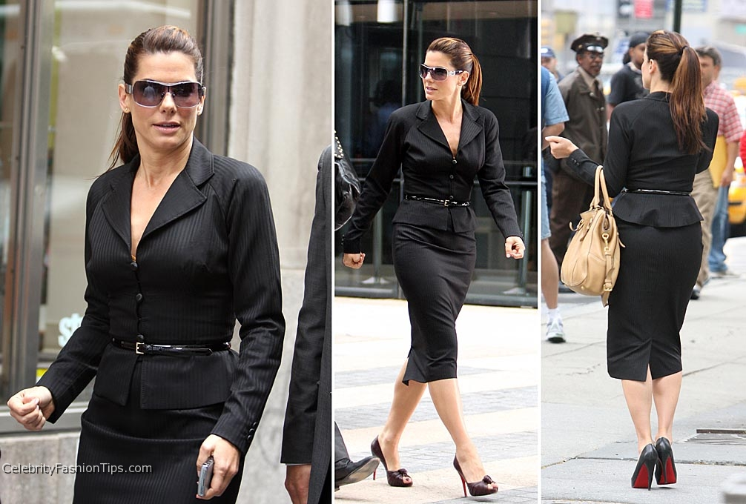
Dress for Success
2012
Today’s Dress speaks to:
  Style
  Sense of Self
  Where you're going

Slide 3
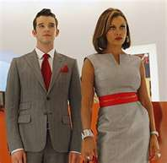
Dress for Success
2012
Today’s Rules…
Good news
  Not only blue/black suits
  More color
  Freedom of style
  Business Casual
Bad news
  All the above

Slide 4

Dress for Success
2012
This still applies…….
Dress for the job that you want.

Slide 5

Dress for Success
2012
First Factor
  What you wear
Dressing for the occasion
  Work
  Interview
  Conference
  Casual Friday

Slide 6
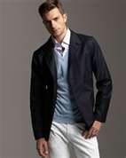
Dress for Success 2012
Dressing for the occasion
  Mistakes of Business Casual
    Flip Flops
    Sweat Pants
    Halter Dresses/Shorts
    Running/Gym Shoes
    Remember that you are still at work.

Slide 7
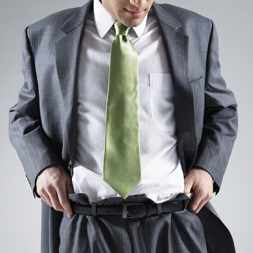
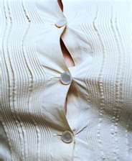
Dress for Success
2012
Second Factor
How does it fit?
  Too small
  Too big
  Wrinkled

Slide 8
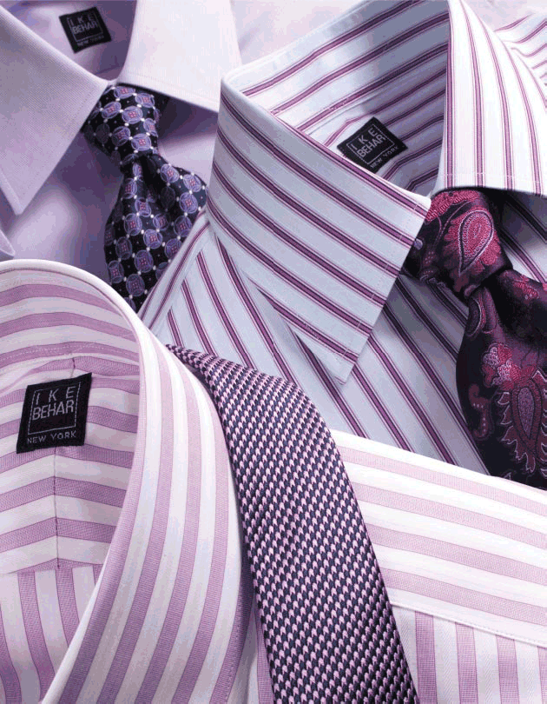
Dress for Success
2012
Excuses
  No Dress Code
  Comfort
  Knowledge
  Don’t have time
  Cost
  Solutions
  Look at the person that has your future job
  Buy clothes that fit well
  Make time at night
  TJ Maxx/Consignmentstores

Slide 9
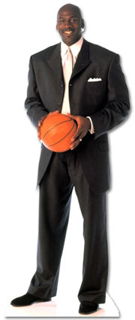
Dress for Success 2012
Get in the game!
Must have…..
A suit M&W
Blazer W
White Shirt M&W
Nice Black Shoes M&W
  (Nice shine for men)
Tie M
Professional Dress/
Slacks W
Minimum Accessories

Slide 10
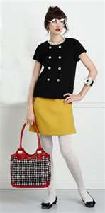
Dress for Success 2012
What ever your sense of style is…
Own it!
Nothing wears as well as confidence!

