Slide 1
Lean6 Program
Jeff Carrillo
Lean Six Cleveland

Slide 2
Lean6 Mission and Goals
Lean6 Mission
NEW! Lean6 Mission
Our mission is to solidify Lean6
principles as the method of
continuous process improvement
while supporting achievement
of DFAS’ strategic goals.
Leading strategic performance
Improvements through structured
methods, analytics and innovation.
Lean6 Vision
NEW! Lean6 Vision
Our DFAS Lean6 vision is
to become DoDs leading provider of
Continuous Process Improvement.
Business improvement
solution leaders
for tomorrow.
3/8/2012
Integrity - Service - Innovation
2

Slide 3
Lean6 Values
Built on Agency values
Actionable
Foundation for success

Slide 4
Lean6 – Organization Chart
Pre-Reorg
Post Reorg
Enterprise Management Services
(HC)
Enterprise Management Services
Lean6
(HCJ)
Lean6
(HCJ)
Lean6 Columbus
(HCJA)
Lean6 Operations
(HCJA)
Lean6 Strategy & Support
(HCJB)
Lean6 Cleveland
(HCJB)
Lean6 Indianapolis
(HCJC)
Lean6 Rome
(HCJC)
Lean6 Rome
(HCJC)
Lean6 Rome
(HCJC)
3/8/2012
Integrity - Service - Innovation
4

Slide 5
Lean6 – What We Do
Personnel Development
Training
  Black Belt
  Green Belt
  Champion/Sponsor
Certification
  Black Belt
  Green Belt
  Master Black Belt
  Task
    Trainer
    Coach
    Certifier
Communities of Practice
Continuing Education
  New Skills
  Maintaining Certification
Policy/Procedures
Methodology
Documentation
Outreach
  OSD
  Components
  Federal Sector
  Public/Private Partnership
Idea Process
Reporting
BSC
Project Status
Ad hoc
7
8
21
ODAA
Administration
  PowerSteering
  Property
  Software
  Contracts
  Personnel
Facilitation
Agency teams
21
Projects
Execution
Coaching
Strategic Initiatives
Scoping
Identification
21
3/8/2012
Integrity - Service - Innovation
5

Slide 6
Coaching
Critical activity
  Reduces training time and variability
  Increases results
Core staff carrying 73% load
  More experience/cycles of learning
  All Black Belts
MBB/Core
1:5
Rotational Black Belts
1:20
Green Belts

Slide 7
Lean6 – The Journey
Lean6 empowers our employees with the skills, abilities and tools to make a real difference!
The Past
Yesterday
Today
2004 – Program started
2005 – Centralized PMO
2006 – Business Diagnostics
2007 – Leadership emphasis
Fully self sufficient (training, coaching, projects)
Emphasis on Department-wide collaboration
Projects aligned to highest priority strategic initiatives
FY09
FY10
FY11
374 Projects
$96M ROI
2783 Trained People
564 Projects
$120M ROI
3500 Trained People
622 Projects
$125M ROI
3674 Trained People
Green Belts: 741
Black Belts: 57
Green Belts: 1191
Black Belts: 95
Green Belts: 1353
Black Belts: 97
7

Slide 8
Lean6 Evolution
Continuous Improvement Part of DFAS Strategy
GS14/15’s added to Black Belt Rotation
Senior Leaders
Green Belts
Trained
First SES
Black Belt
Certified
BENEFITS
Increased results
=
Increased support
Supervisors’ Forum
Focused
on Lean6
First SES
Certified
TIMELINE
3/8/2012
Integrity - Service - Innovation
8
Notes:
8

Slide 9
Maturation of Lean6 – FY11
Strategy driven projects
  Increased leadership accountability
  Higher priority projects
Project timeliness
  Apply project management discipline to Lean6 projects
Validated results
  Increased visibility of savings
  Visibility of disposition of savings
Transition from Process Improvement to Performance Improvement

Slide 10
Lean6
Core Lean6 Trained/Certified
 |  | Prior Yrs. | FY10 | FY11 | CUM.
TRAINED | Master BB | 5 | 6 | 0 | 11
 | Black Belts | 8 | 2 | 0 | 10
CERTIFIED | Master BB | 1 | 4 | 0 | 5
 | Black Belts | 8 | 2 | 0 | 10
Agency Lean6 Trained/Certified
 |  | Prior Yrs. | FY10 | FY11 | CUM.
TRAINED | Master BB | 0 | 2 | 0 | 2
 | Black Belts | 136 | 18 | 18 | 172
 | Green Belts | 2340 | 567 | 282 | 3189
CERTIFIED | Master BB | 0 | 0 | 0 | 0
 | Black Belts | 50 | 39 | 8 | 97
 | Green Belts | 723 | 405 | 225 | 1353
Project Accomplishments
 | Prior Yrs. | FY10 | FY11 | CUM.
Black Belt | 148 | 82 | 16 | 246
Green Belt | 226 | 108 | 38 | 372
3/8/2012
Integrity - Service - Innovation
10
Notes:
Trained/ certified does not include those that have left the agency – however the journey chart does.

Slide 11




DFAS 2011–2016 Strategy Map
Vision: To be a recognized leader in DoD’s financial management by consistently delivering first-class service and products.
Customer Collaboration
Continuous Improvement
Operational Excellence
Customer Collaboration
Strategic
Results
Achieve clearly defined, negotiated expectations through partnerships that balance fact-based requirements, enterprise standards, and cost realities.
Demonstrate a culture of innovation delivering new capabilities and improving existing operations.
Achieve service excellence and superior results through a high-performing workforce, effective analytical capabilities, and standardized procedures.
Agency
Continuous Improvement
Strategic
Objectives
Improve Customer Satisfaction
Improve Cost Efficiencies
Lean6
Organizational
Strengthen Partnering Processes
Improve Service Excellence
Improve Business Processes and Controls
  Build a Culture of Service Excellence and Innovation
Increase Employee Satisfaction
Improve Talent Management
Leverage Technology
And increase customer satisfaction.
Provide proactive, user-friendly products and services
Customer
Improve customer relations
Demonstrate service excellence
Increase efficiency and value…
Financial
Provide solutions/support at least cost
Increase quality and productivity
Achieve expected financial outcomes
Employee Contributions
Internal
Improve processes…
Through meaningful analysis & collaboration
Employ continuous improvement processes/tools
Execute standardized operating procedures
Organization
Capacity
Engage, equip, empower & align our people to…
Understand client/customer needs
Target improvement opportunities
Demonstrate functional expertise & personal leadership
Lead using Integrity, Service, and Innovation
Mission: Lead the DoD in finance and accounting by ensuring the delivery of efficient, exceptional quality pay and financial information.
11
Notes:
Assigned MBB to each objective owner. Projects we’re working are in the bubbles – we are the central theme

Slide 12
Lean6 Support to Strategic Objectives
Improve Business Processes and Controls | Idea Generator Shared Capabilities | OC4, I1, I2, I3
 | Think Tank Incubator | OC4, I3, F1, C1
 | Lean6 Reorganization/ Strategic Alignment | OC4, I3, F1, C1
 | Celebration | OC4
LEGEND
OC4 Build a Culture of Service Excellence and Innovation
I3 Improve Service Excellence
F1 Improve Cost Efficiencies
C1 Improve Customer Satisfaction
Idea Generator
  Simplified idea submission process
  Facilitation of general and targeted idea generation
  Publication of ideas and opportunities to be involved
  Management of idea lifecycle
Think Tank/Incubator
  Support BCA
Celebration
  Execution of reporting process
3/8/2012
Integrity - Service - Innovation
12
Notes:
Lean6 is spear heading Idea Generator and realigning resources to improve support to senior leadership, while providing internal advisor to objective owners.

Slide 13
Lean6 – what’s next
Addition of Financial Approver gate in PowerSteering
  Ensures accuracy of initial and final estimated savings
  Locks estimates
  Formalizes/documents financial review/assumptions
Structured Innovation
  Capitalize on Innovation/Ideas
  Provide discipline to address complex issues when required
  Introduce new skillset/tools
Execute Reorganization
3/8/2012
Integrity - Service - Innovation
13

Slide 14
Lean6 Alignment to Agency Structure
Director, DFAS
(Furman)
Principal Deputy Director (PDD), DFAS
(Furman)
Deputy Director,
Operations (DDO)
(James)
Chief of Staff
(Wright)
Deputy Director, Strategy & Support (DDSS)
(Glendenning)
Internal Review
(Wright)
Office of General Counsel
(Wright)
Indianapolis/Texarkana
(Connor/Vick)
Enterprise Solutions & Standards (ESS)
(Iselo)
Strategy, Policy and Requirements (SPR)
(M. Moxley)
Enterprise Management Services (EMS)
(Lordier/Smith)
Columbus/Limestone
(L. Moxley/Bossie)
Cleveland/Japan
(Carrillo)
Information & Technology (IT) (Lindsay)
Resource Management (RM)
(Serowik)
Rome/Europe
(Facci)
Audit Readiness (AuR)
(Griffin)
Corporate Support Activities
(Muniz-Sanchez)
Personnel Development
(Downing)
Corporate Communications
(Serowik)
Human Resources (HR)
(Layton)
Equal Employment Opportunity (EEO)
(Layton)
14
Notes:
As mentioned in the Director’s video you saw yesterday, the new organization structure will include the Director, Mrs. McKay, her Principal Deputy Director, Mr. Gustafson, and her other two current Deputies, Mr. Turner and Ms. Zmyslinski.
Under Mr. Steve Turner in Operations, there is a new organization called Enterprise Solutions and Standards.
Moving to the right side of the chart, the SBM organization will evolve and be combined with other support organizations in fiscal year 2012. Ms. Nancy Zmyslinski will lead this new organization as the Deputy Director, Strategy & Support (DDSS). With the exception of Office of General Counsel and Internal Review, corporate organizations will now report to Ms. Zmyslinski as the DDSS.
14

Slide 15
Changing a Culture by Managing Change
A DFAS Journey
Jeff Carrillo
Lean Six Cleveland
Notes:
Introduction and Bio by facilitator (I am assuming)
Fill in any gaps
Establish rapport with the group

Slide 16

Overview
Entrance Ramp
  Change
  Management
  Change Management
Route
  DFAS Journey
Exit
  Strategy
  Way forward
  Q&A
Just kidding! There are only 18!
Slide 2 of 98
Notes:
Entrance Ramp = background
Route = the story of the CPI journey within DFAS
Exit = DFAS Strategy Map is a reflection of the cultural change that has begun; what we plan to do in order to continue

Slide 17




Change
33 definitions
Change is everywhere
Change allows us to adapt
Change: to become different
"change." The American Heritage® Dictionary of the English Language, Fourth Edition. Houghton Mifflin Company, 2004. 04 Jun. 2010. <Dictionary.com http://dictionary.reference.com/browse/change>.
Notes:
Change is constant and all around us
Change oil
Change diapers
Change clothes/styles
Change roads (detours)
Change grades/schools
Change is natural adaptive behavior. We do it all the time.
Let me plant the seed of a question to ponder for the next few minutes:
change
tʃeɪndʒ/ Show Spelled [cheynj] Show IPA verb, changed, chang·ing, noun
–verb (used with object)
1.
to make the form, nature, content, future course, etc., of (something) different from what it is or from what it would be if left alone: to change one's name; to change one's opinion; to change the course of history.
2. to transform or convert (usually fol. by into ): The witch changed the prince into a toad.
to become different: Overnight the nation's mood changed.
to become transformed or converted (usually fol. by into ): The toad changed into a prince again.

Slide 18

Management
Management: the act or manner of managing; handling, direction, or control
Provides the structure and boundaries
"management." Dictionary.com Unabridged. Random House, Inc. 04 Jun. 2010. <Dictionary.com http://dictionary.reference.com/browse/management>.
Notes:
Examples of management:
Org chart
Guard rails
Traffic signs
Handcuffs/prison bars
What does management have to do with change? Why does change have to be managed?
man·age·ment
ˈmæn ɪdʒ mənt/ Show Spelled[man-ij-muh nt] Show IPA
–noun
1. the act or manner of managing; handling, direction, or control.
2. skill in managing; executive ability: great management and tact.

Slide 19

Change Management
Lets put the two together:
  Change Management – trying to control or direct the transformation of something to be different
200 million results in a Google search
  Why is this such a huge topic?
  What are the risks of change without management?
Prepare for Change
(Define and Design)
Manage Change
(Implement)
Reinforce Change
(Reinforce)
Define the
Create a
Develop a
Lead the
Engage and Mobilize
Create
Align Systems
Sustain the
Change
Shared Need
Shared Vision
Change
Stakeholders
Accountability
and Structures
Change
Notes:
So let’s put the two together
Change and management: we are trying to control or direct the transformation of something to be different from what it is or from what it would be if left alone
So, if change occurs without management, what are the risks?
I propose that change management is nothing more than good management; part of your everyday management, but a critical part

Slide 20
DFAS Journey
An example using DFAS CPI
  DFAS wanted to ‘change’
  Shift from problem solving to process improving
Lean6 Definition
Lean6 is our fact-based approach for improving our business processes and delivering best value to our customers.
Leadership Council - January 16, 2004
Notes:
Let’s talk about an example of change:
It all started in a little defense agency about 6 years ago…
DFAS wanted to ‘change’ to a fact based, continuously improving culture
Problem solving = firefighting and hero worship
Process improving = proactive, root cause, preventative/sustainable
Agency had come a long way based on firefighting, but it would not get us where we needed to be.

Slide 21

Burning Platform
Why change?
  a war (a very costly war)
  record deficits
  demands for less costly government
  Basic customer satisfaction
Cost reduction/downsizing mindset
Couldn’t afford to follow ‘gut’ instincts
Notes:
Let’s think about the change fro a PESTEL analysis
Political Economic Social Technological Environmental Legal
(engage group in coming up with the platform for change)

Slide 22


Rough Start
Marketing challenges
Flavor of the Month
Spotty support
Revolving leadership
Decentralized approach
Notes:
Did we start out with good intentions? Yes
Did we truly manage the change? No, hence the rough start.
Marketing challenge: yet another initiative, more change in a change saturated environment. Lean organization, thank you very much!
Flavor of the month: why bother, this won’t last long
Some believers, but it was spotty based on the leader
Program went through many leaders (I am 13th and I have been in the position 3 years out of 6)
Each business area owned their own

Slide 23

Enter ‘Management’
SES corps agreed to ‘walk the talk’
  100% training goal
  Certification expected
Reorganized program
  Centralized
  Under supportive chain of command
Stabilized program manager position
Established corporate level metrics
  Balanced Score Card
  Training => Certification
  Benefits
Notes:
It became somewhat obvious that the program wasn’t getting the desired results. This change needed to be managed,
The Executives agreed that if this was going to work, they had to show real support
The program consolidated and became a corporate effort
The program was moved under a very supportive and strong leader
A new program manager was hired (notice the position was stabilized, nit the incumbent)
Corporate level metrics were created and reported regularly
Emphasis changed from training to certification to focus on results

Slide 24

Show Results
A few key projects in supportive environments
  DFAS Audit
  Commercial Payments
  21 Day Reporting
  DSR
Direct System
Reimbursement
Disbursement Rejects
Notes:
During this early period we did have some success
Results started getting some attention

Slide 25

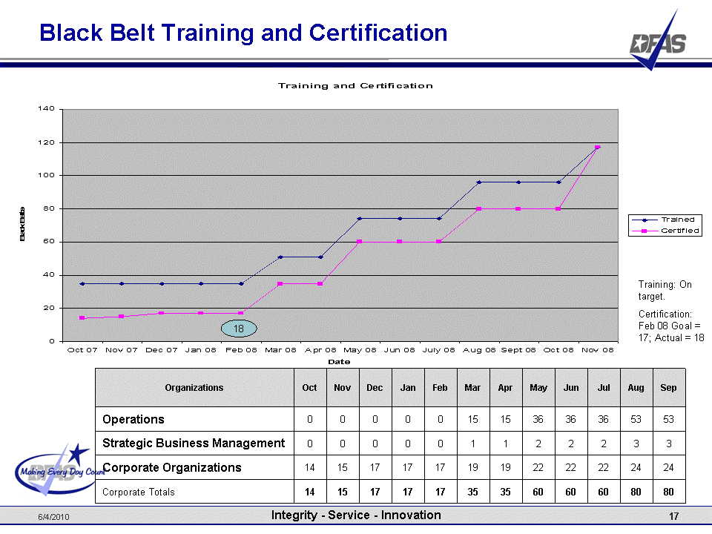
Accountability
Notes:
A key part of the management was establishing accountability
Accountability wasn’t all for the Lean6 folks.
Accountability was set for the business areas of DFAS (all inclusive)
This was a big shift because it moved from a what is this program doing, to how are we improving.

Slide 26

Momentum
Early successes feed further opportunities
Marketing and Communications make Lean6 part of the vocabulary
Leadership support
  Agency Director trumpets support/successes
  Supervisor’s forum dedicated to Lean6
  Lean6 element included in performance plans for supervisors
  Developmental assignments
Notes:
All of these change management actions have set up a momentum that is building
We now have good support
Folks want to do projects, they want to earn their certifications

Slide 27
Credibility
GS14/15’s added to Black Belt Rotation
First SES
Black Belt
Certified
Senior Leaders
Green Belts
Trained
Increased results
=
Increased support
Supervisors’ Forum
Focused
on Lean6
First SES
Certified
Notes:
Another benefit of the results is the credibility that comes with it.
This chart depicts the relationship between the results/credibility and the benefits achieved.

Slide 28

Way Forward
We’re not done yet
  Culture has started the shift
  Need to keep it moving
May not always be smooth
Make it part of the DNA
  It’s not something we do
  It’s how we think and act
Notes:
Have we made it? No. There is still a lot of work to do.
We need to harness and manage the momentum that we have built to ensure we achieve our vision state
I don’t expect a smooth, even road, but that’s ok. We’ve learned a lot about how to keep the car on track.

Slide 29

RECAP
Manage change or it will manage you
Incorporate ‘Change Management’ into your everyday management
Focus on results and outcomes; they are your best change management tools
CPI CULTURE DRIVE
VIA
CHANGE LANE
Notes:
If you are trying to change something, you have to utilize your management skills.
A new initiative or ‘change’ that is left to run its own course… will (and you may not like where is goes)
Change management is just good management, everyday management, oundry management
Results are your best change management tools.

